Slide 1
Asynchronous Counters

Slide 2
Lecture Overview
Classifications of Counters
Definitions
Asynchronous Counter…
J – K Flip Flops
D Flip Flops
Up Counters
Down Counters
Truncated Counters
Design Example

Slide 3
Classifications of Counters
Asynchronous Counters
Only the first flip-flop is clocked by an external clock. All subsequent flip-flops are clocked by the output of the preceding flip-flop.
Asynchronous counters are slower than synchronous counters because of the delay in the transmission of the pulses from flip-flop to flip-flop.
Asynchronous counters are also called ripple-counters because of the way the clock pulse ripples it way through the flip-flops.

Slide 4
Classifications of Counters
Synchronous Counters
All flip-flops are clocked simultaneously by an external clock.
Synchronous counters are faster than asynchronous counters because of the simultaneous clocking.
Synchronous counters are an example of state machine design because they have a set of states and a set of transition rules for moving between those states after each clocked event.

Slide 5
States / Modulus / Flip-Flops
The number of flip-flops determines the count limit or number of states.
(STATES = 2 ^{# of flip flops})
The number of states used is called the MODULUS.
For example, a Modulus-12 counter would count from 0 (0000) to 11 (1011) and requires four flip-flops (16 states - 12 used).

Slide 6
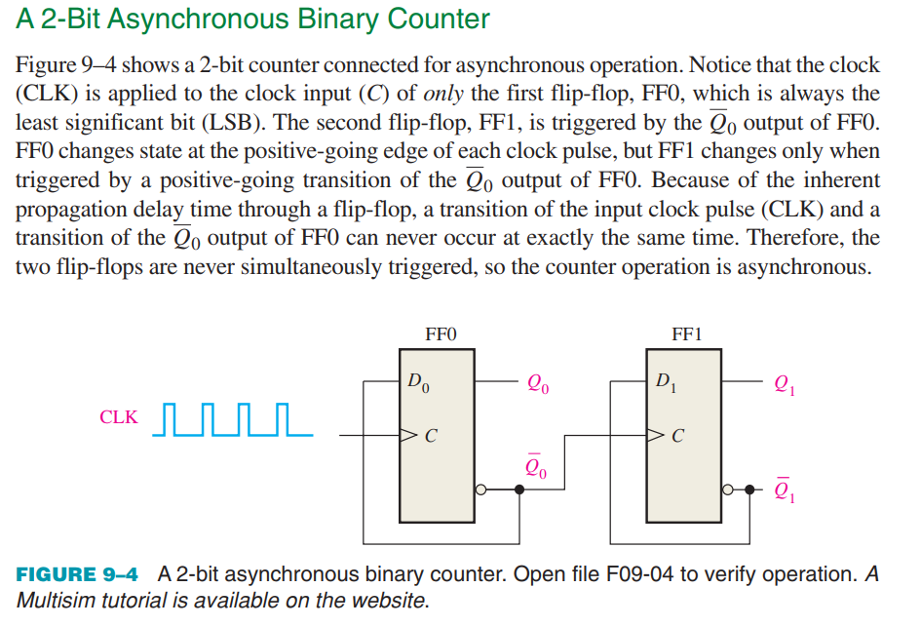

Slide 7

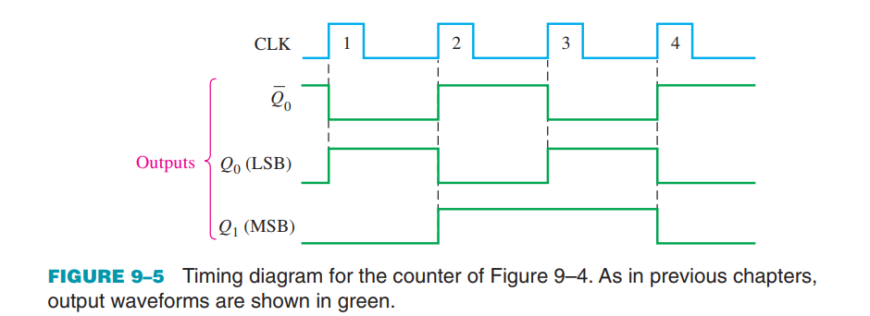
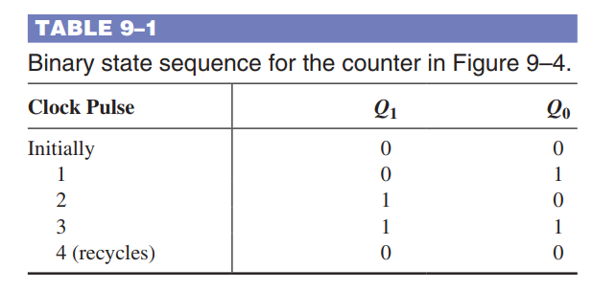

Slide 8

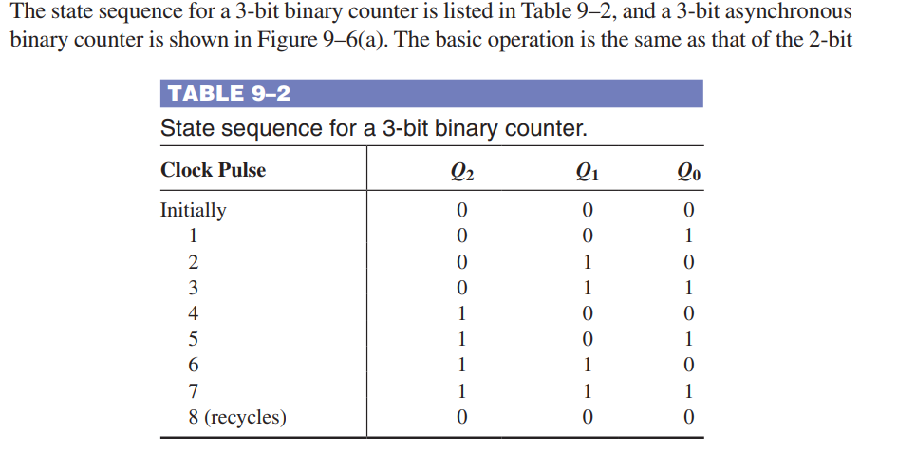
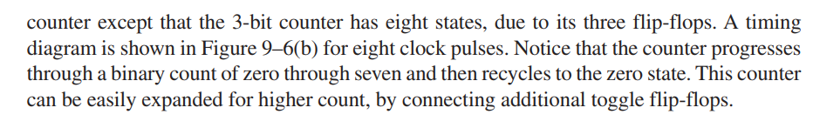

Slide 9
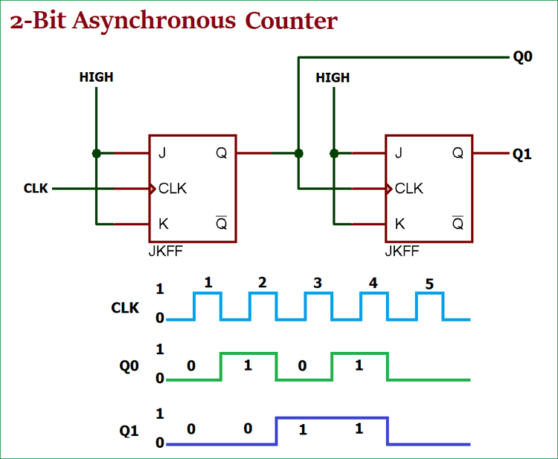
2-Bit Asynchronous Counter using JK flip flop

Slide 10
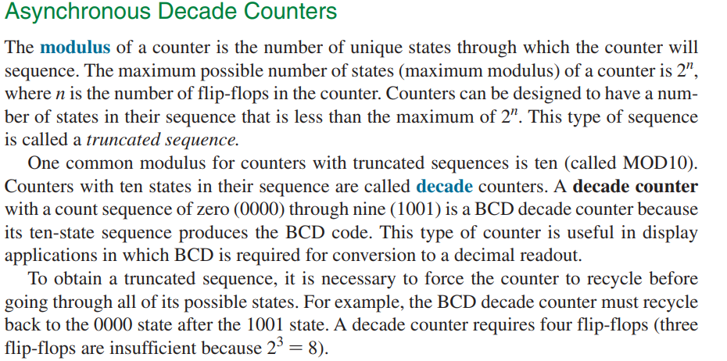

Slide 11
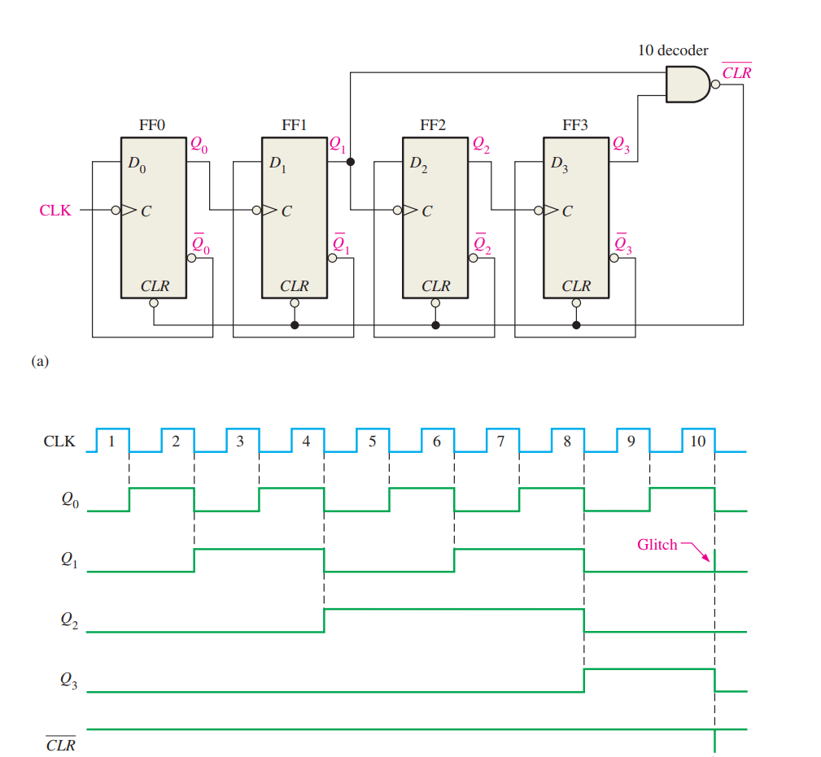

Slide 12
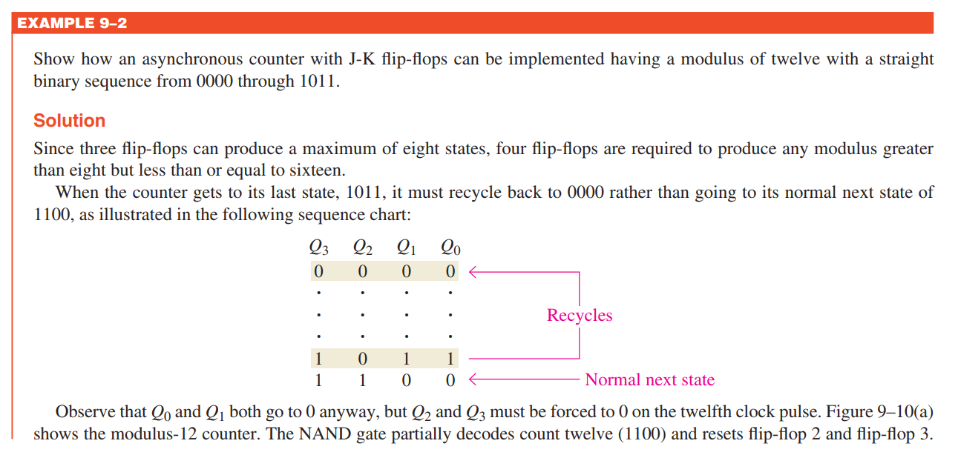

Slide 13
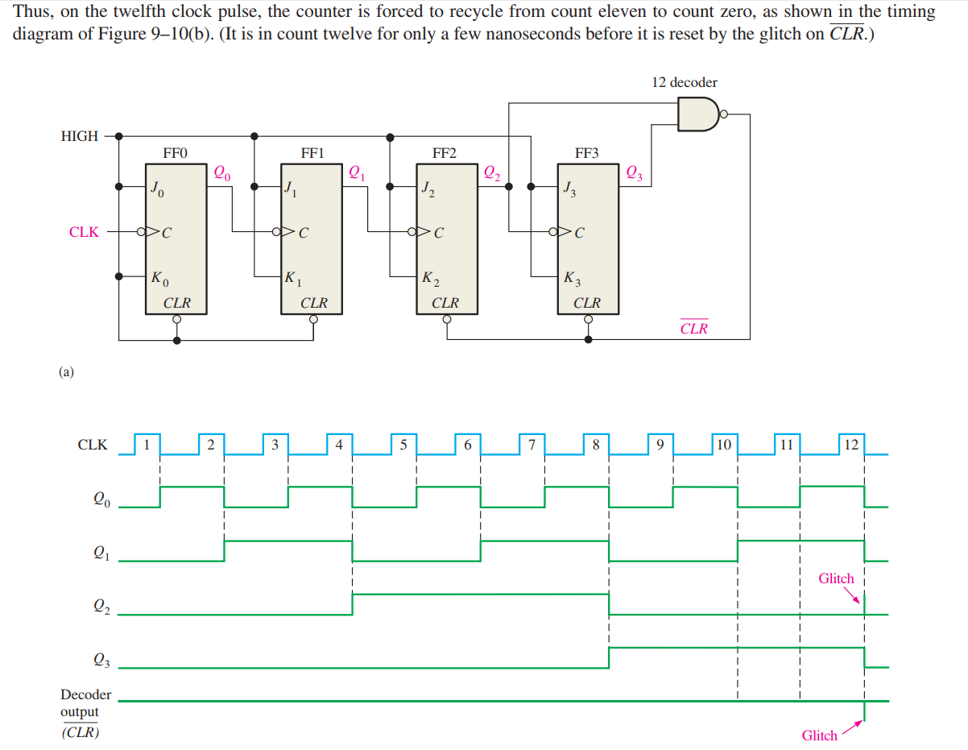

Slide 14
Asynchronous Counter Design Steps
Select Type
Up or Down
Modules
Select Flip-Flop Type
J-K or D
Positive Edge Trigger (PET) or Negative Edge Trigger (NET)
Determine Number of Flip-Flops
(2^{# Flip-Flop} ≥ Modules)

Slide 15
Asynchronous Counter Design Steps
Design Basic Counters
Same polarity for down counters:
Opposite polarity for up counters:
Design Limits Logic
Input to logic is count that is one past the end of sequence.

Slide 16
Design Example
Select Type
Up or Down
Modules
Select Flip-Flop Type
J-K or D
Positive Edge Trigger (PET) or Negative Edge Trigger (NET)
Determine Number of Flip-Flops
(2^{# Flip-Flop} ≥ Modules)
MOD – 14 (0..13)
2^{4 Flip-Flop} ≥ 16

Slide 17
Design Example
Design Basic Counters
Same polarity for down counters:
Opposite polarity for up counters:
Design Limits Logic
Input to logic is count that is one past the end of sequence.
Limit 13+1 = 14 (1110)

Slide 18
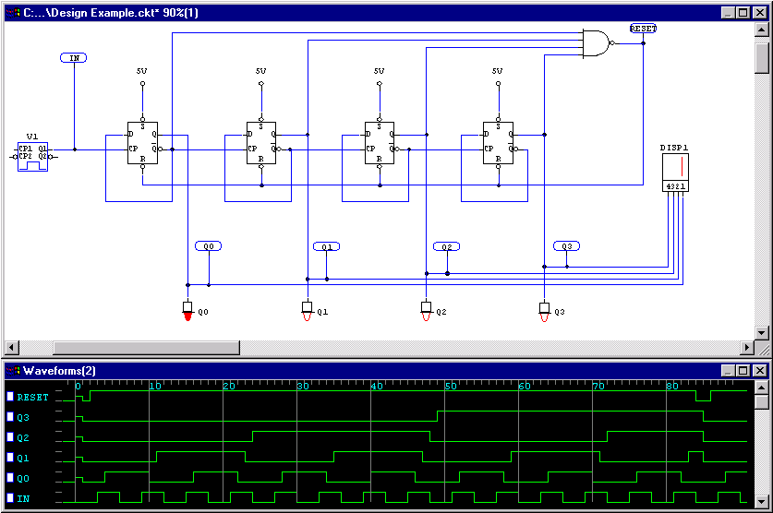
Design Example…Solution

Slide 19
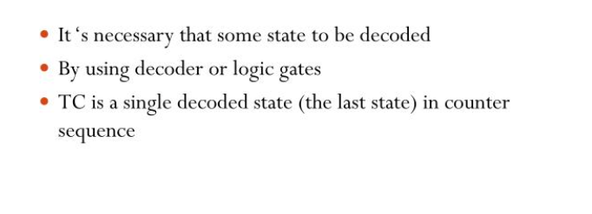
Counter Decoding

Slide 20
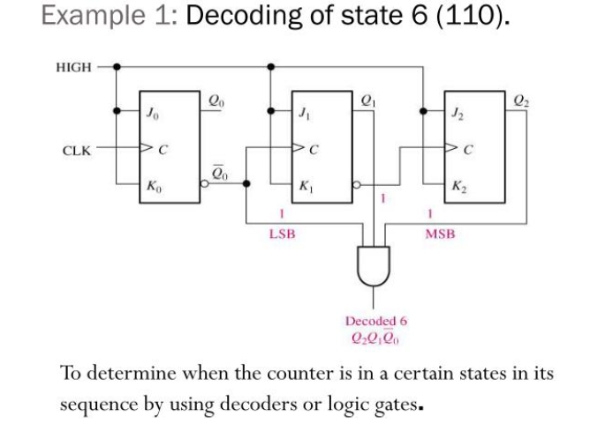

Slide 21
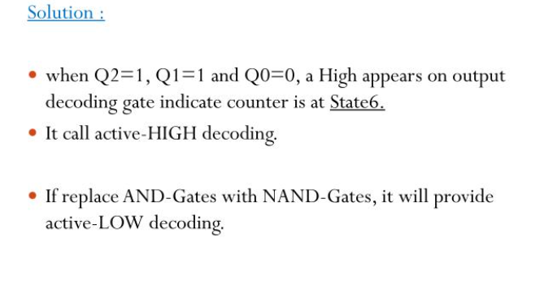

Slide 22

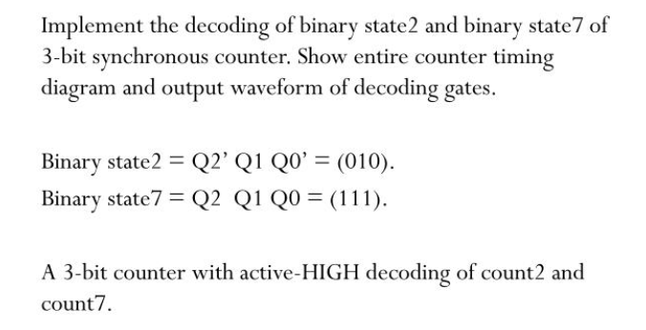

Slide 23

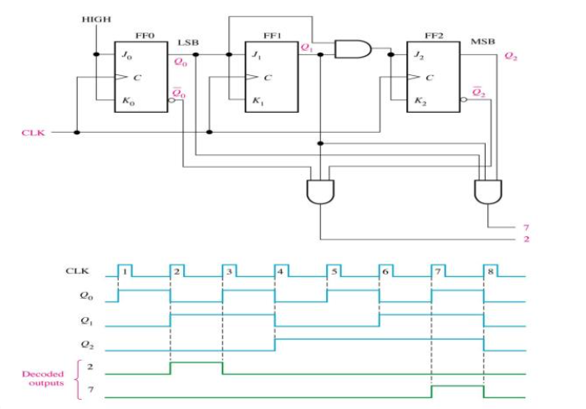

Slide 24
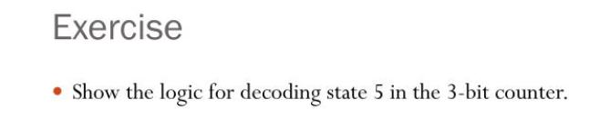

Slide 25
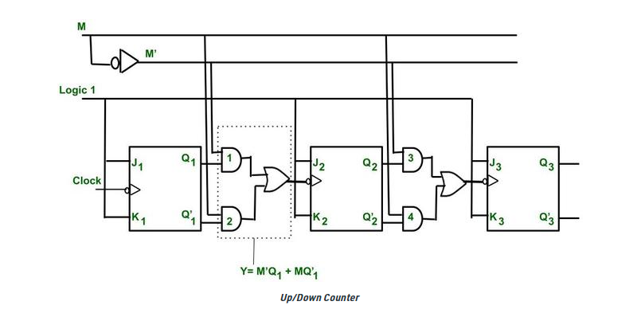
Asynchronous Up/Down Counter

Slide 26
